Slide 1

CH 42010: PROCESS PLANT OPERATION & SAFETY
LTP: 3-0-0, CRD: 3
Breadth Elective for Spring Semester 2024-25
Offered by Chemical Engineering Department
Course Instructors
Dr. Joydip Chaudhuri & Dr. Rahul Ranjan
joy@che.itkgp.ac.in
rahul@che.iitkgp.ac.in

Slide 2
CH 42010: PROCESS PLANT OPERATION & SAFETY
LTP: 3-0-0, CRD: 3
Lecture 1
Process Plants

Slide 3
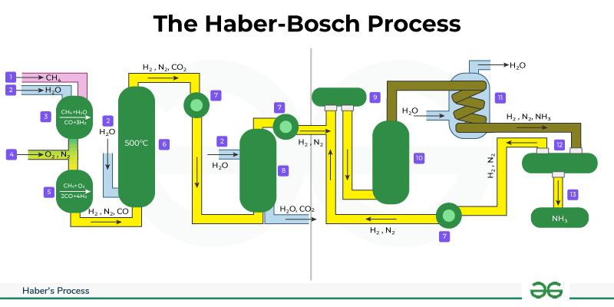
PROCESS PLANTS
A “process plant” (or more simply “plant”) is “a complete set of process units and direct supporting infrastructure required to provide a total operational function to produce a product or products…”.
Q: What is the industrial procedure to produce ammonia called?
The German chemists Fritz Haber and Carl Bosch developed the process in the first decade of the 20th century.
Its improved efficiency over existing methods such as the Birkeland-Eyde and Frank-Caro processes was a major advancement in the industrial production of ammonia.
The Haber process can be combined with steam reforming to produce ammonia with just three chemical inputs: water, natural gas, and atmospheric nitrogen.
Two individual Nobel Prizes in Chemistry: Haber in 1918 for ammonia synthesis specifically, and Bosch in 1931 for related contributions to high-pressure chemistry.

Slide 4
PROCESS PLANTS
Q: What is the industrial procedure to produce ammonia called?
In 1905, Fritz Haber had published his book on the thermodynamics of technical gas reactions, in which he recorded the production of small amounts of ammonia from N₂ and H₂ at a temperature of 1000° C with the help of iron as a catalyst.
Later he decided to attempt the synthesis of ammonia and this he accomplished after searches for suitable catalysts, by circulating nitrogen and hydrogen over the catalyst at a pressure of 150-200 atmospheres at a temperature of about 500° C.
This enabled Germany to prolong World War I in 1914.
Modifications of this Haber process also provided ammonium sulphate for use as a fertilizer for the soil.
Ammonium sulphate is made by treating ammonia with sulfuric acid: 2 NH₃ + H₂SO₄ → (NH₄)₂SO
The principle used for this process and the subsequent development of the control of catalytic reactions at high pressures and temperatures, led to the synthesis of methyl alcohol by Alwin Mittasch and to the hydrogenation of coal by the method of Bergius and the production of nitric acid.
Ammonia is very useful – Fertilizers, Explosives, Ostwald Process, etc.
Ostwald Process is a three-step process that starts with (i) oxidation of ammonia, (ii) ammonia is turned into nitric oxide and then nitrogen dioxide, (iii) finally, this nitrogen dioxide is turned into nitric acid.

Slide 5
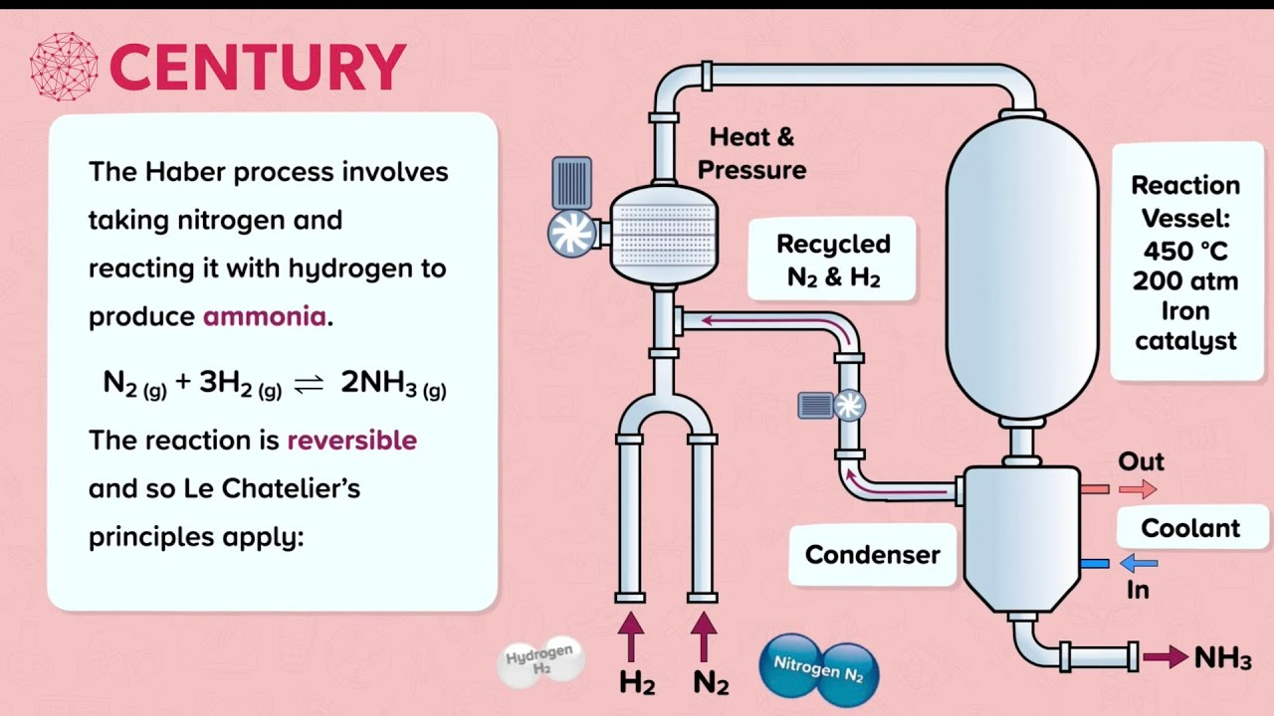
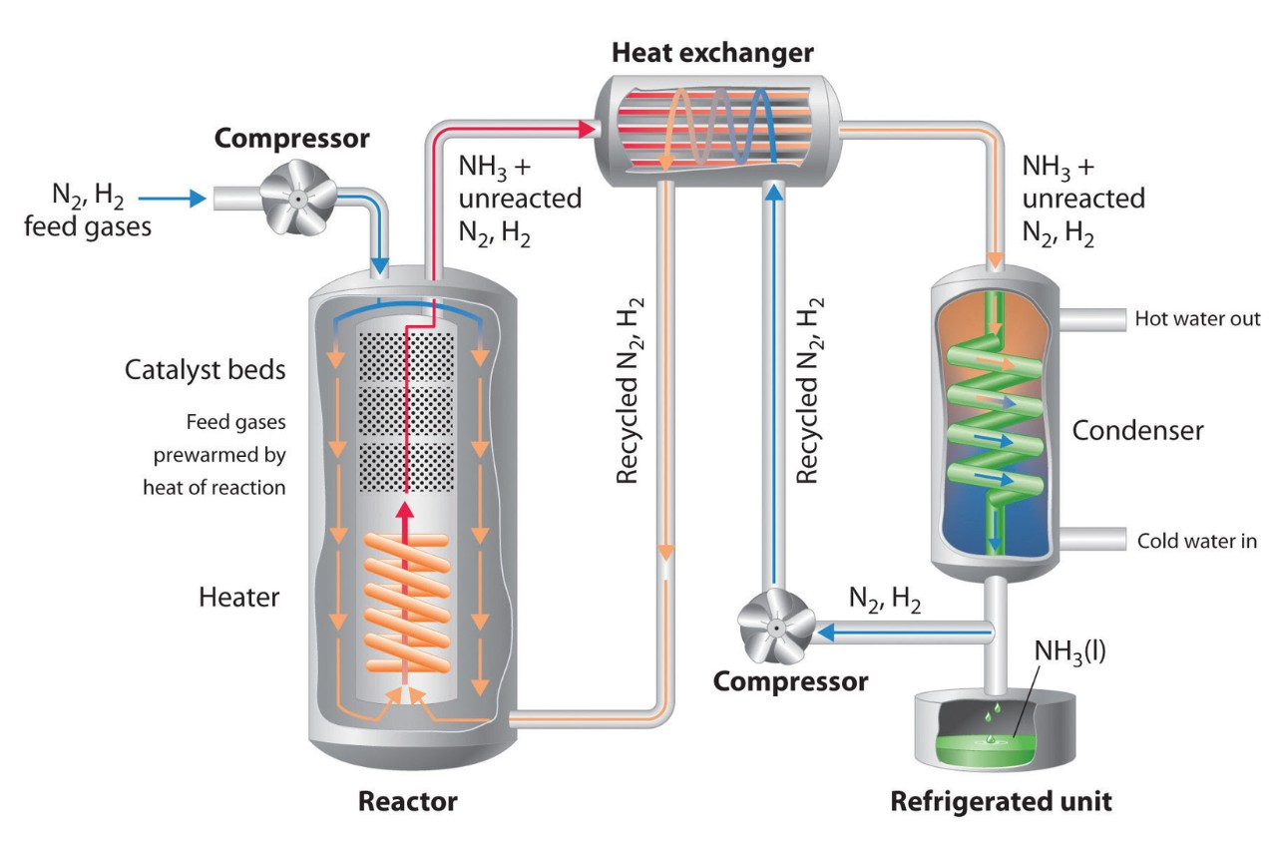
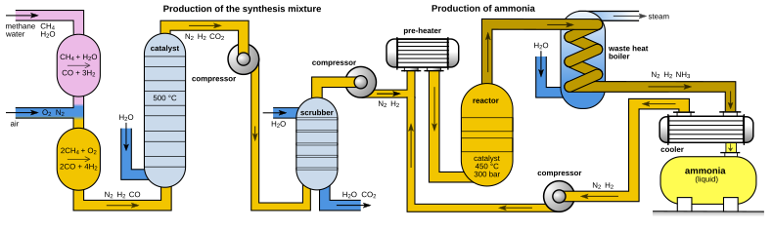
PROCESS PLANTS
Q: What is the industrial procedure to produce ammonia called?
Source: Google Images

Slide 6
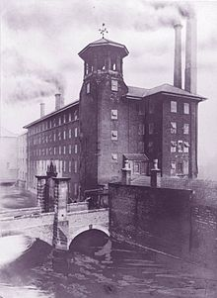

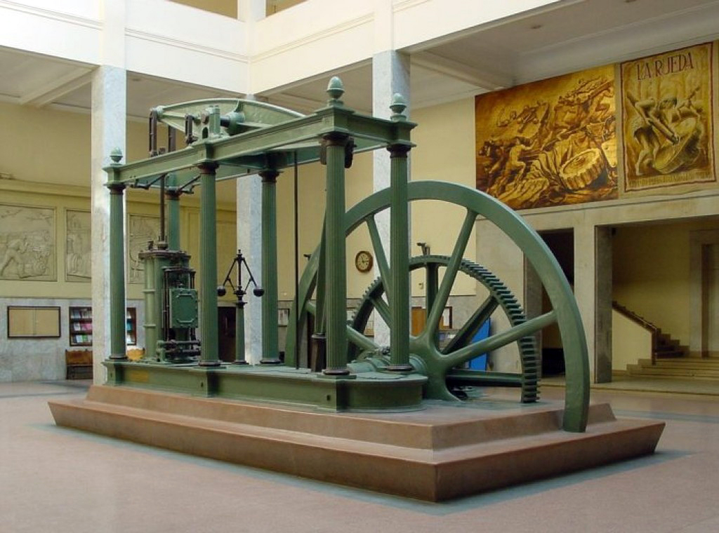
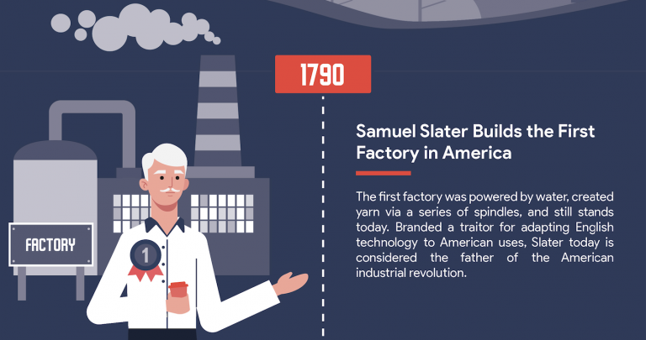
FIRST FACTORIES OF THE WORLD
1721: John Lombe's water-powered silk mill at Derby, England
Early period: most industrial power was supplied by water and wind
James Watt: Watt steam engine in 1776
Industrial Revolution (1760 –1840)
Derwent Valley Mills World Heritage Site
Source: Google Images

Slide 7
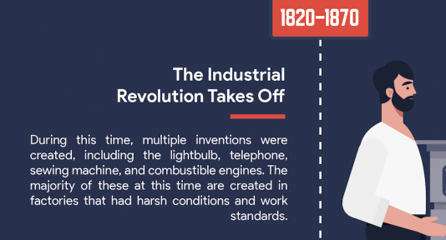
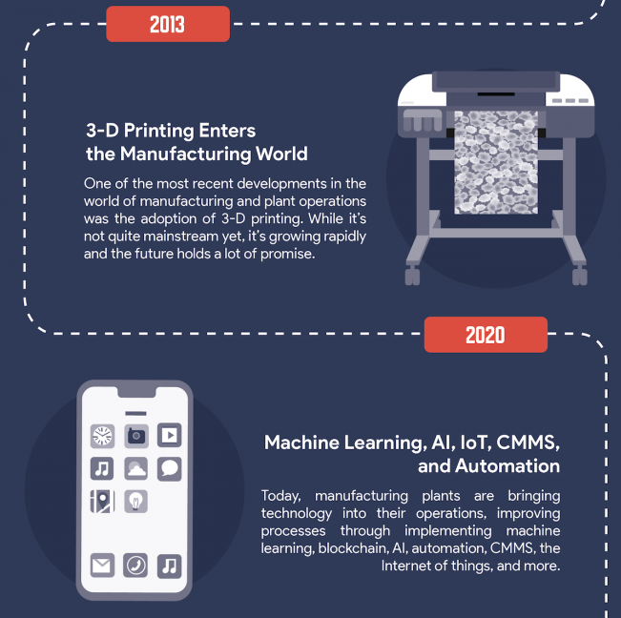
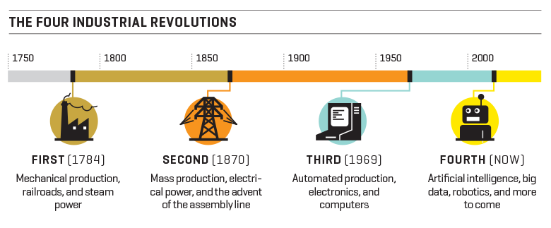
INDUSTRIES
Some Important Timelines
1870 onwards: Manufacturing Process: Interchangeable parts, Production lines etc.
Early 1900: Automobile Industry Line: Henry Ford
1957: FORTRAN - communicate to the newest technology
1971: Occupational Safety and Health Act (OSHA)
1973: Introduction of Industrial Robots - ABB Robotics and KUKA Robotics
1980: The Rise of Computers – Push towards Automation by Softwares
INDUSTRY 4.0
INDUSTRY 1.0
INDUSTRY 2.0
INDUSTRY 3.0
INDUSTRY 4.0
Source: Google Images

Slide 8

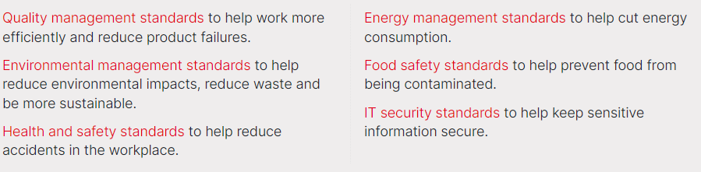
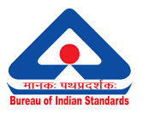

INDUSTRY STANDARDS
ISO 9001: 2015 Certified Company
International Organization for Standardization (ISO)
23 February 1947
Earlier, International Federation of the National Standardizing Associations (ISA)
ISA: 1926
ISO 45001: Standard for management systems of occupational health and safety (OHS) - 2018
Bureau of Indian Standards (BIS)
23 December 1986
Indian Standards Institution (ISI)
Effective from 1950s
Source: Google Images

Slide 9





COMPONENTS OF AN INDUSTRIAL FACILITY
Process Plants & Manufacturing
Control & Safety
Others
Control Systems
Programmable Logic Controllers (PLCs)
Distributed Control Systems (DCS)
Supervisory Control and Data Acquisition (SCADA)
Human-Machine Interface (HMI)
Quality Control and Testing Facilities
Laboratories and Testing Equipment
Inspection and Monitoring Systems
Non-Destructive Testing (NDT) Equipments
Safety and Environmental Systems
Fire and Explosion Protection Systems
Pollution Control Systems
Emergency Shutdown Systems (ESDS)
Personal Protective Equipment (PPE) and Safety Gears
Production Equipments
Reactors, Mixers
Conveyors, Material Handling Systems
Extruders, Crushers, Grinders
Heat Exchangers, Boilers, Furnaces
Pumps, Compressors
Utilities and Auxiliary Systems
Water Treatment Systems
Compressed Air Systems
Power Generation, Distribution Systems, Cooling Systems
Steam, Gas Supply Systems
Storage and Material Handling
Storage Tanks and Silos
Bulk Material Handling Systems
Warehousing and Inventory Systems
Piping and Plumbing Systems
Process Piping
Valves and Fittings
Drains and Sewer Systems
Data and Communication Systems
Industrial Network Infrastructure
Data Logging and Analysis Systems Enterprise Resource Planning (ERP) Systems
Buildings and Structural Components
Production Facilities
Warehouses and Storage Areas
Administrative and Office Areas
Structural Support Systems
Logistics and Distribution
Loading and Unloading Docks
Packaging Systems, Transport Vehicles
Workforce Amenities and Facilities
Locker Rooms, Changing Areas
Medical & First Aid Facilities
Administrative and Office Areas
Maintenance and Workshop Facilities
Workshops, Maintenance Equipment
Spare Parts Inventory

Slide 10
PROCESS PLANT OPERATION
Process Plant Operation
Process Plants & Manufacturing
What?
Systematic management and control of equipment, machinery, and systems within a manufacturing or processing facility.
Commonly found in industries such as oil and gas, chemicals, pharmaceuticals, food and beverages, power generation, and water treatment.
Why?
Efficiently convert raw materials into desired products.
Ensure safe, efficient, and reliable production while maintaining product quality and minimizing environmental impact.
How?
Will learn in this course: CH42010 – Process Plant Operation !!!
Prerequisites: Fluid Mechanics, Heat Transfer, Mass Transfer I & II, Transport Phenomena, Reaction Engineering, Thermodynamics, Refinery Engineering, Equipment Design etc.
Production Equipments
Reactors, Mixers
Conveyors, Material Handling Systems
Extruders, Crushers, Grinders
Heat Exchangers, Boilers, Furnaces
Pumps, Compressors
Utilities and Auxiliary Systems
Water Treatment Systems
Compressed Air Systems
Power Generation, Distribution Systems, Cooling Systems
Steam, Gas Supply Systems
Storage and Material Handling
Storage Tanks and Silos
Bulk Material Handling Systems
Warehousing and Inventory Systems
Piping and Plumbing Systems
Process Piping
Valves and Fittings
Drains and Sewer Systems

Slide 11
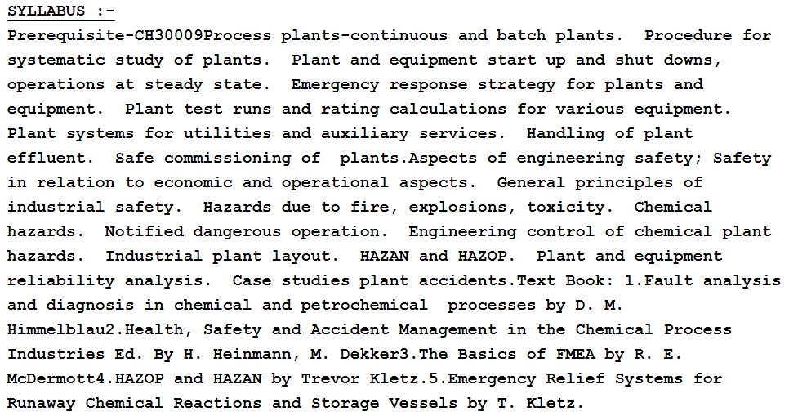
PROCESS PLANT OPERATION
Other Textbooks
Ian Sutton, Plant Design and Operations, Gulf Professional Publishing (2014)
Process Plant Equipment, Operation, Control, and Reliability, Edited By Michael D. Holloway, Chikezie Nwaoha, Oliver A. Onyewuenyi
Stanley M. Walas, Chemical process equipment selection and design, Butterworths (1990)
Martin Killcross, Chemical and Process Plant Commissioning Handbook. A Practical Guide to Plant System and Equipment Installation and Commissioning, Elsevier (2021)
Myself
Prof. Rahul Ranjan
List of Textbooks and Reference Books

Slide 12
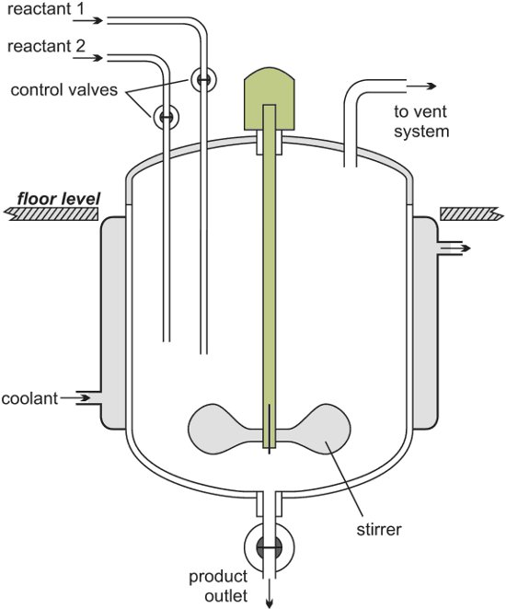
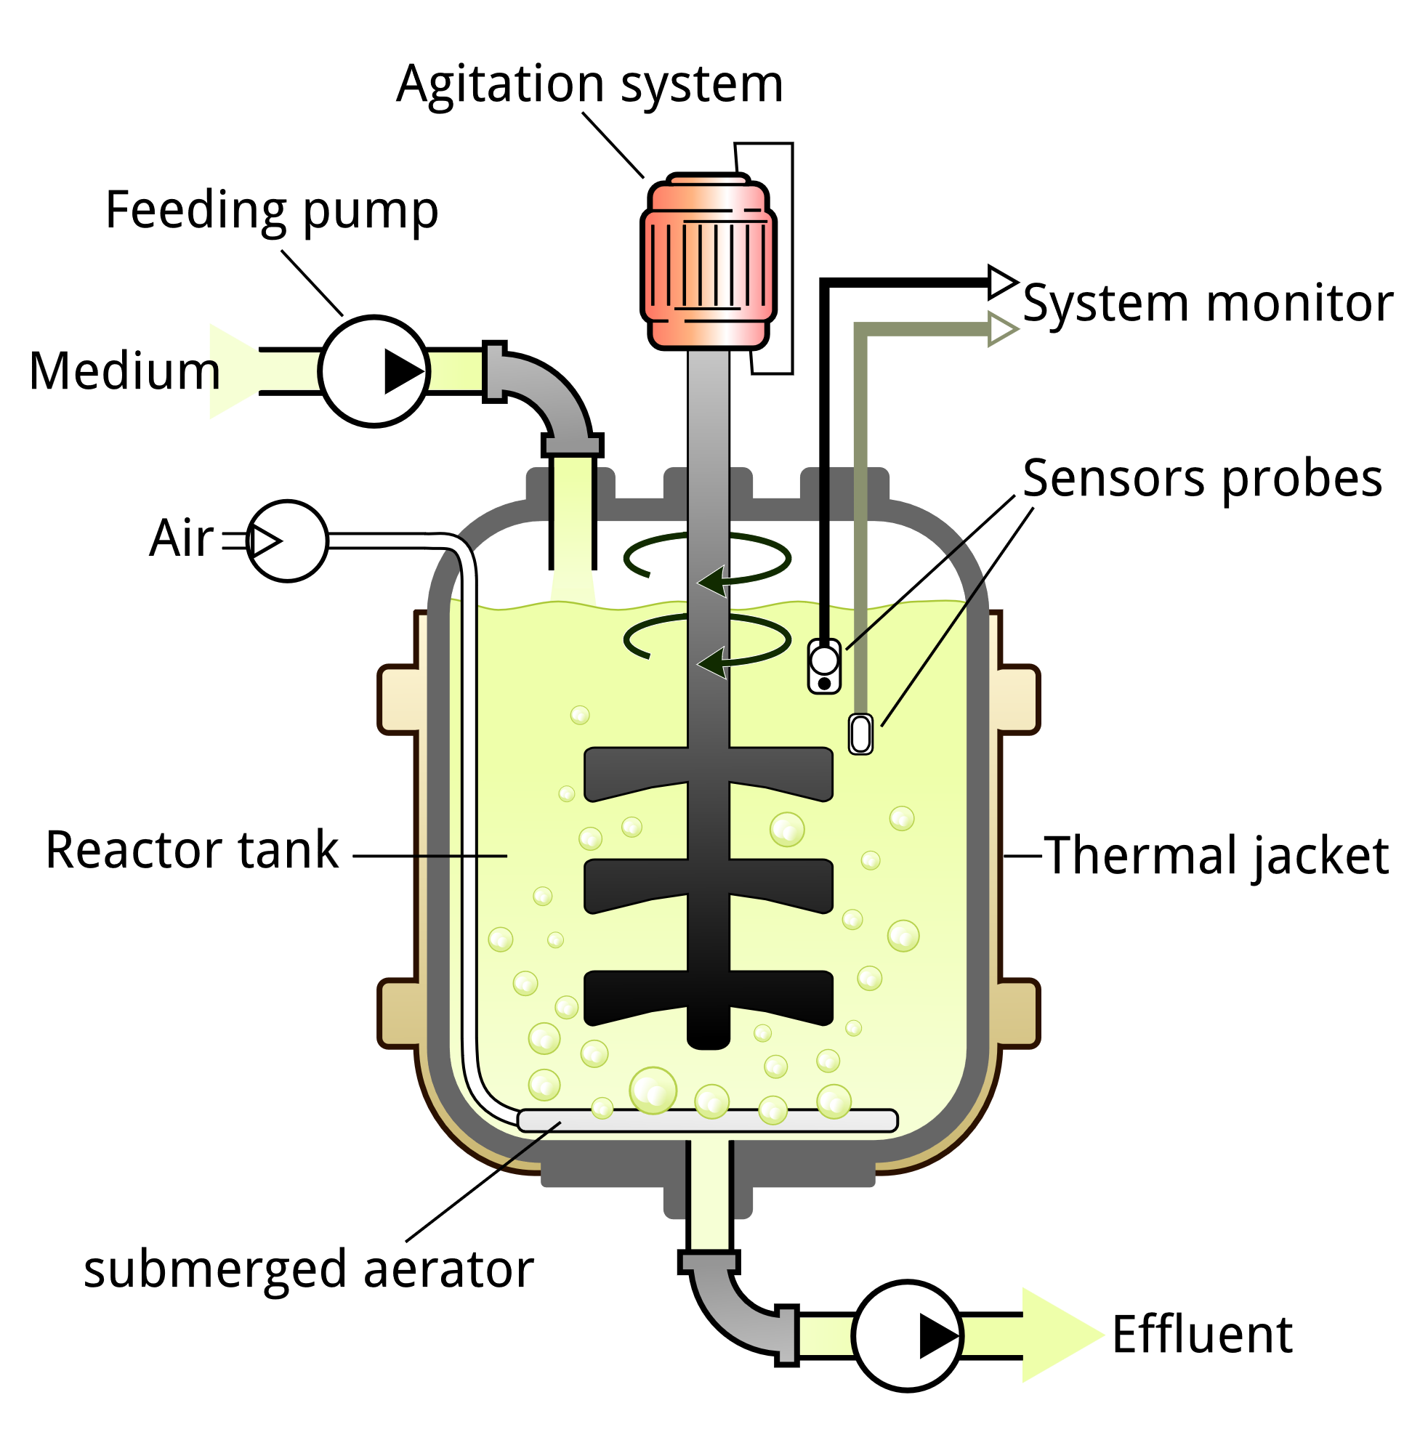
PROCESS PLANTS – BATCH & CONTINUOUS PROCESSES
Batch Processes
Continuous Processes
Processes where materials are processed in discrete batches. Each batch goes through the entire production cycle before the next batch is started.
Processes where raw materials are continuously fed into the process, and products are continuously produced.
Source: Google Images
Batch Reactor
Food and Beverage Production
Fermentation, Coagulation
Batch Polymerization
Fermentation processes for producing antibiotics, enzymes, and biofuels
Heat treatment processes: metal components are heated and cooled in controlled batches for hardness and durability
Continuous Stirred Tank Reactor (CSTR)
Tubular reactors
Fixed bed reactors
Fluidized bed reactors
Oil Refining: Distillation, Cracking, Hydrotreating
Chemical Manufacturing: Ammonia, Methanol, Sulfuric Acid Production
Source: Google Images
Advantages:
Greater flexibility to produce a variety of products.
Easier to manage smaller production runs.
Lower initial capital investment.
Disadvantages:
Higher production costs per unit due to downtime and cleaning.
Variability in product quality between batches.
More labor-intensive operations.
Advantages:
Higher efficiency and lower operational costs per unit of product.
Consistent product quality due to steady-state conditions.
Lower labor costs due to automation.
Disadvantages:
High initial investment and operating costs.
Limited product flexibility.
Maintaining steady-state operations (e.g., startup and shutdown).

Slide 13
PROCESS PLANTS – BATCH & CONTINUOUS PROCESSES
Characteristics | Batch | Continuous
Flow Process | Intermittent flow; materials are added, processed, and removed in distinct stages | Uninterrupted flow of materials
Production Rate | Varies depending on the size and duration of each batch | Steady and consistent output
Time of Operation | Operates in cycles, with downtime between batches | Operates continuously, often 24/7
Process Control | Easier to control on a per-batch basis, often requiring less sophisticated control systems | Requires complex control systems to monitor and maintain parameters (temperature, pressure, flow rates)
Flexibility | Highly flexible; can produce various products by changing batch recipes and operating conditions | Less flexible; designed for a specific product and often requires extensive modification to switch products
Equipment | Equipment such as mixers, reactors, and tanks that can be cleaned and reused for different products | Typically involves large, capital-intensive equipment like reactors, heat exchangers, and distillation columns
Fundamental
Operational

Slide 14
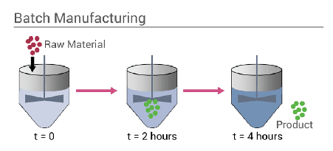
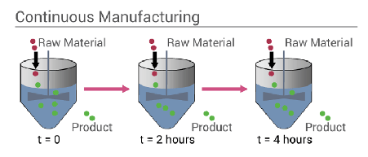
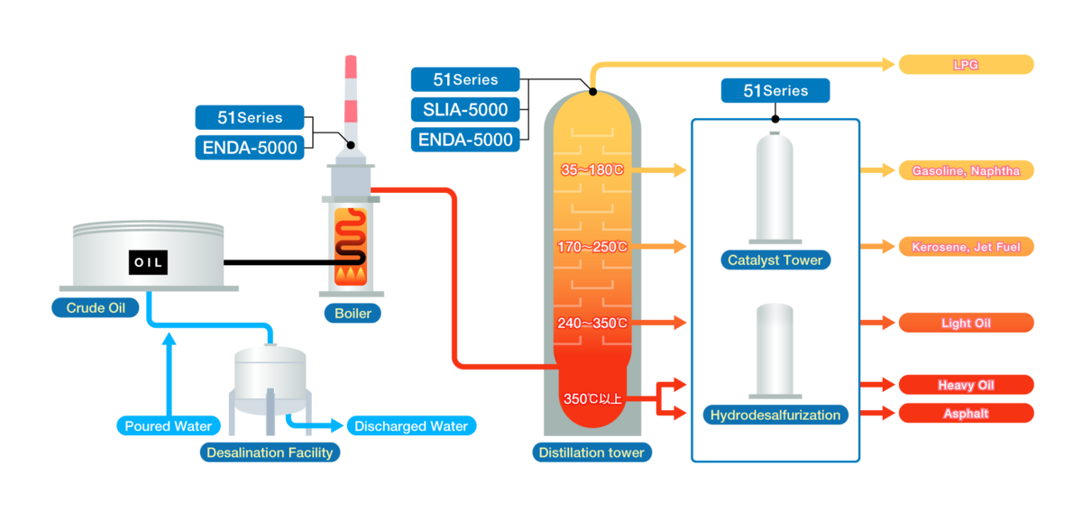
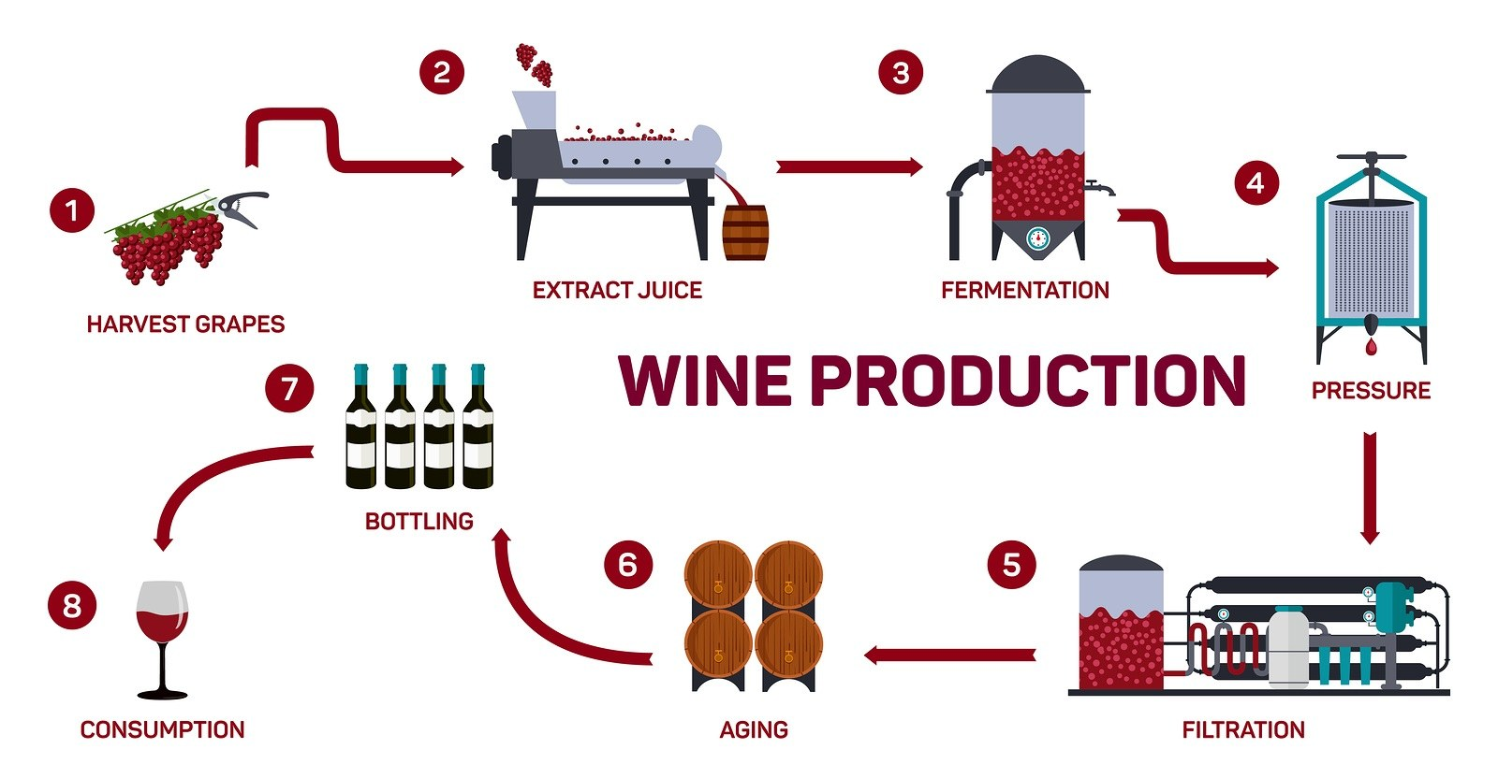
APPLICATIONS OF BATCH AND CONTINUOUS PROCESSES
BATCH PROCESSES
Pharmaceutical production (e.g., vaccines)
Food industry (e.g., baked goods, sauces)
Specialty chemicals (e.g., perfumes, dyes)
CONTINUOUS PROCESSES
Chemical manufacturing (e.g., ammonia production, petrochemical processing).
Food production (e.g., juice extraction, syrup production).
Power generation (e.g., steam generation in power plants).
Source: Google Images

Slide 15
SELECTION: BATCH AND CONTINUOUS PROCESSES
Economic Considerations
Cost Analysis:
Fixed and variable costs in continuous vs. batch production.
Economies of scale in continuous operations.
Return on investment (ROI) for both types of processes in plants.
Market Demand:
How market demand influences the choice between continuous and batch production.
Trends in manufacturing practices and technology (e.g., shift toward more flexible manufacturing systems).
Safety and Environmental Considerations
Risk Assessment:
Different safety risks associated with continuous vs. batch processes (e.g., chemical spills, equipment failures).
Importance of safety protocols and regulations in both types of plants.
Environmental Impact:
Waste management and emissions control strategies for continuous and batch plants.
Role of sustainability in plant design and operation.

